Slide 1
Using land inequality to inform restoration stretegies for the Brazilian dryforest
Felipe Melo Nottingham Trent University - UK Universidade Federal de Pernambuco - Brazil

Slide 2
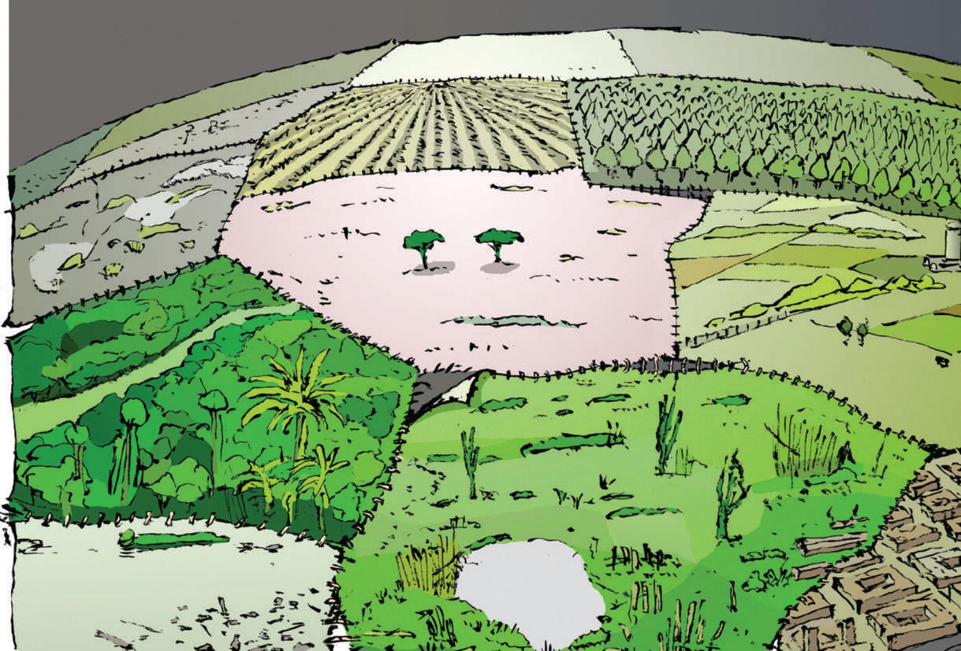
Contents of this talk
A critical appraisal of apolitical restoration
Land inequality and restoration
Restoration to address inequality

Slide 3
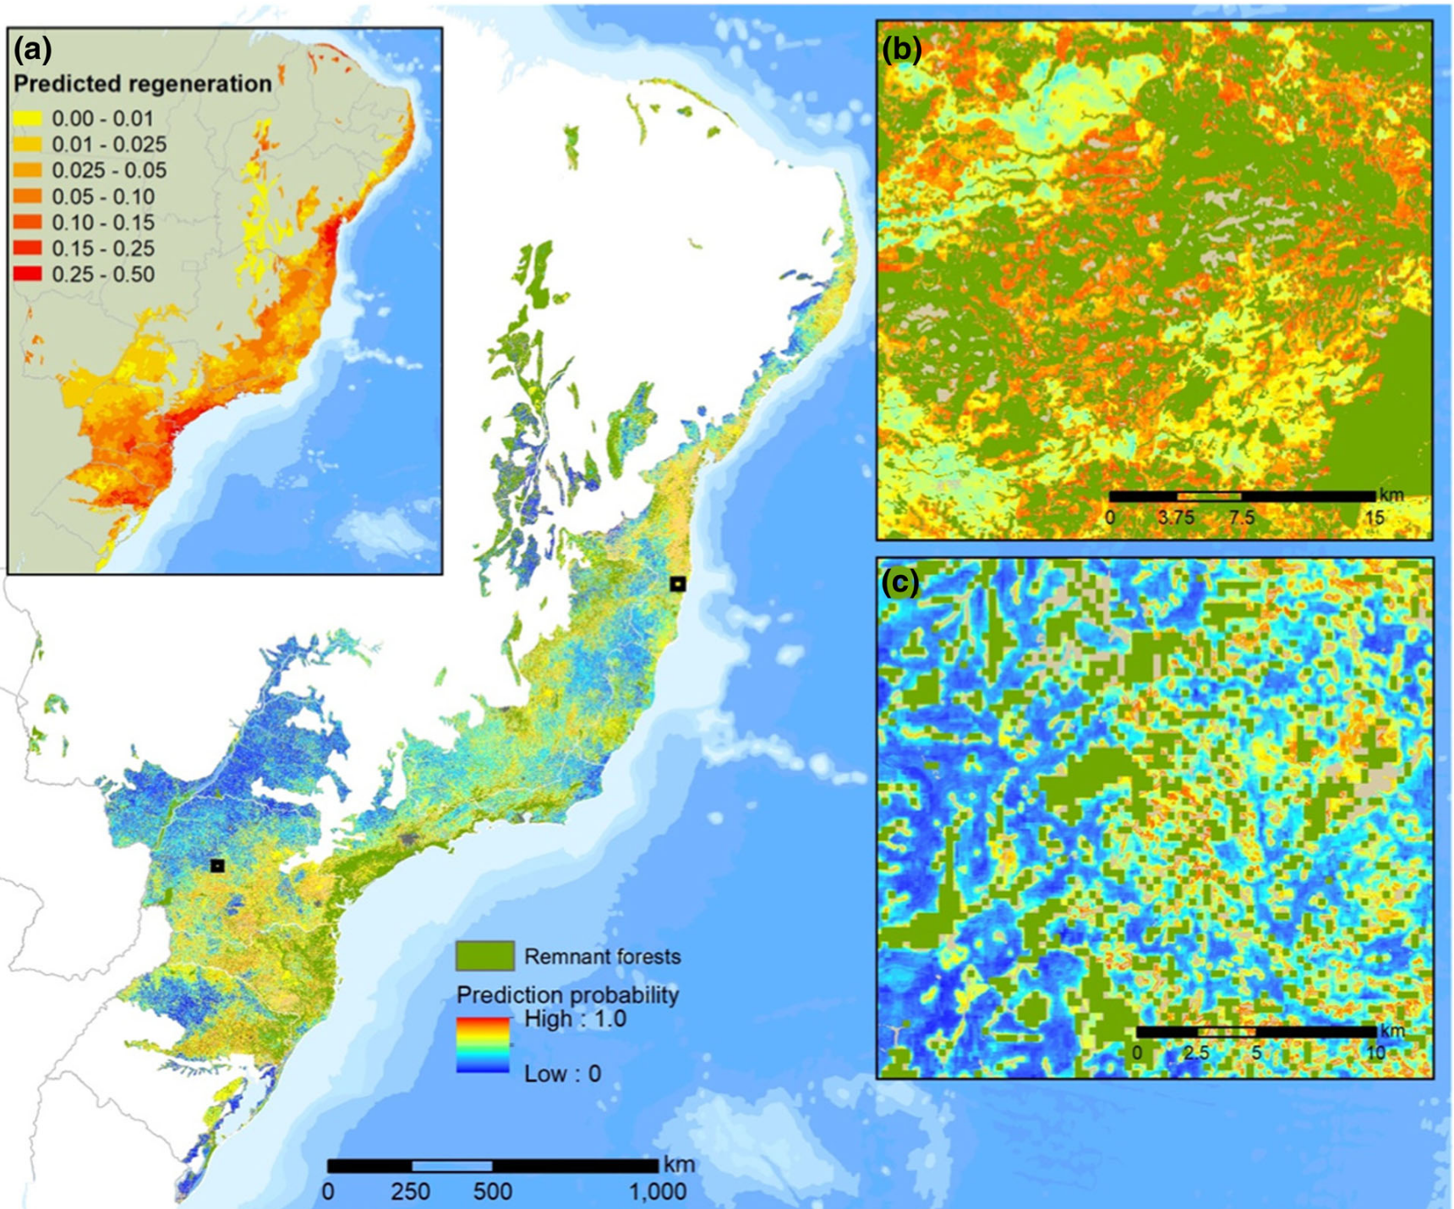
Modeling priorities for restoration
Spatially explicit
Systematic
Multi-criteria
Lack people’s dimensions

Slide 4
Modeling priorities for restoration
Immagined scenarios
Cost-effectiveness
Benefits
Reduced people’s dimensions

Slide 5
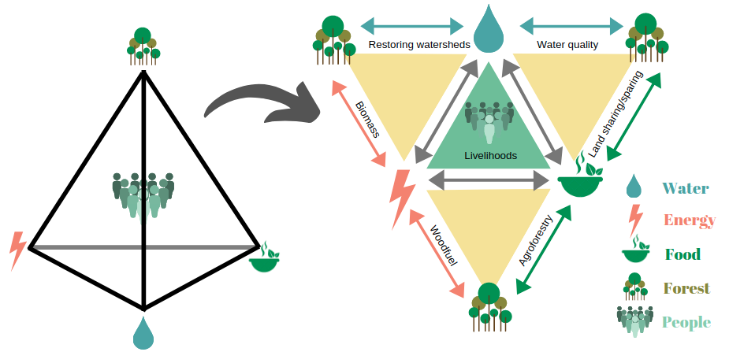
Against apolitical restoration

Slide 6
Melo et al 2021

Slide 7
Our study

Slide 8
Context
Brazil has a rather advanced restortaion movement
Different Biome awereness
Rural poverty + forest poverty
Severe land inequality

Slide 9
Methods
Information on forest cover (MapBiomas.org)
Land tenure database (imaglora.org)
Brazilian Forest Code
Calculate vegetation deficits per property
Small vs large landowners

Slide 10
Land share in Caatinga municiaplities
~ 1 million registered properties in 1204 municiaplities
97.8% Small properties
17.9 Mha
51% forested
2.2% Large properties
15.2 Mha
69% forested

Slide 11
Distribution of legal vegetation deficit
Spatially clumped
Following agribusiness areas

Slide 12
Share of vegetation deficit
Type of landowner | N of properties | Legal Deficit (ha)
Large | 2,986 | 139,644
Small | 141,144 | 143,501

Slide 13
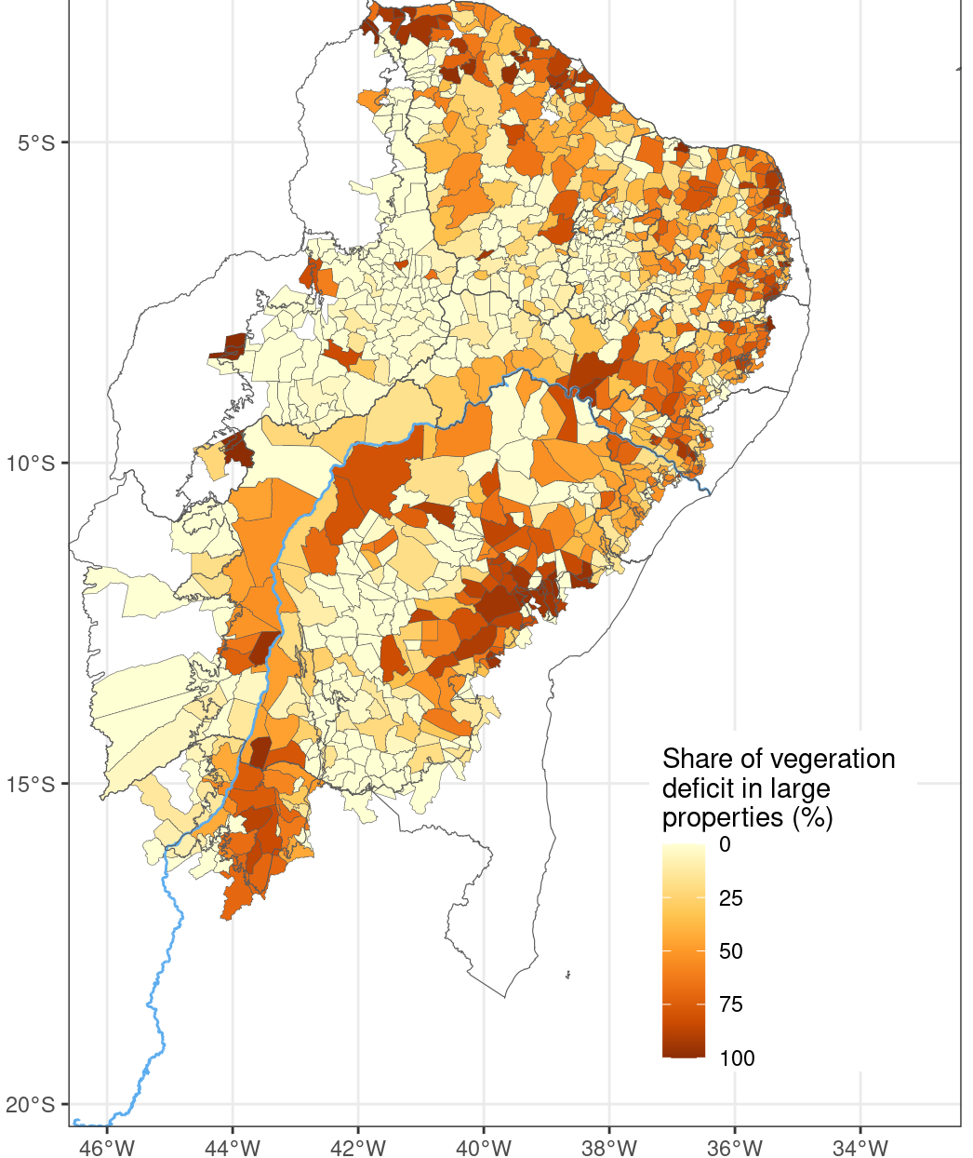
Share of vegetation deficit
Large holders
Spatially clumped (coast and main river)
Following agribusiness areas
Small holders
Dryer regions
Familiar agriculture

Slide 14
Adapated strategies
Type of prevailing deficit | Restoration strategy
Large holders | Active restoration; legal compliance; restoration supply chain
Small holders | Agorforestry; biocutlural restoration
Hybrid | Context dependent combination of all strategies

Slide 15
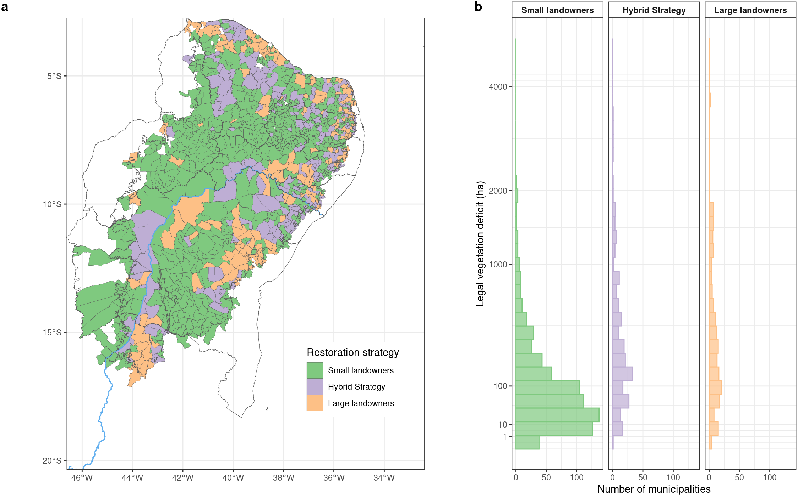
Spatialization of restoration strategies

Slide 16
Restoration must not reproduce land inequality
Smallholders
~1ha
small-scale farms
Scale up agroforestry
Largeholders
~40ha
Intesive land use
Impulse restoration supply chain

Slide 17
What’s next?
Include sensible social information
Account for land inequality
Avoid reproducing injustice
Balance
Marinaho et al 2023

Slide 18
Aknowledgements
Co-authors
Adriana Pelegrinni Manhães
Guilherme Mazochinni
Vinicius Guidoti

Slide 19
Thank you
felipe.melo@ntu.ac.uk
felipe.plmelo@ufpe.br

